Slide 1

Getting Your Security Program to Shift Left: Operationalizing Security Controls

Slide 2

Tony UcedaVélez, CEO/ Founder, VerSprite
VerSprite.com - Global Security Firm​
OWASP Atlanta Chapter Leader (past 10 years)​
Author, “Risk Centric Threat Modeling – Process for Attack Simulation & Threat Analysis”, Wiley June 2015​
Passionate global, threat modeling evangelist​
~25 years of diverse IT/ Security experience in software development, architecture, pen testing, threat modeling, sys admin, security operations​
Dreams of bankrupting #infosec with intelligent, threat inspired DevSecOps automation​

Slide 3
Beyond the Theoretical
DevSecOps Beyond the Whiteboard

Slide 4

What’s Said…
Usually led by overzealous technologist(s)
Multiple technologies downloaded
Limited in-house expertise
Automation utopias promised
80% cost saving projections

Slide 5
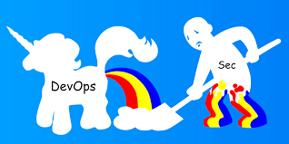
Versus What Actually Happens
Orphaned technologies
Unmaintained repos, VMs, containers, VPCs, etc.
Account sprawl across environments
Lost time, money & credibility

Slide 6
What are we solving via DevSecOps?
Traditional IT Activities Alleviated with Automation
Reducing security control gaps across the stack
Reducing time associated w/ manual configurations
Improving recovery efforts for security incidents
Accelerating common security abuse case testing
Increasing security assurance levels per environment
Assurance vs. Patch Management approaches
Building security requirements into products & platforms
Moving security ‘left’ of implementation SDLC stages
Eliminating vulnerabilities in deployment pipeline
Operationalizing governance

Slide 7
Planning the Shift
DevSecOps Beyond the Whiteboard

Slide 8

Goals of Shifting Left
Ensure that lower Dev environments receive security configurations; not just Prod
Helps reduce environmental discrepancies around security, privacy, and other control factors
Shifting Left can also relate to introducing security earlier in a software development lifecycle
"Operationalize” or automate security efforts via code and Continuous Integration & Continuous Delivery

Slide 9
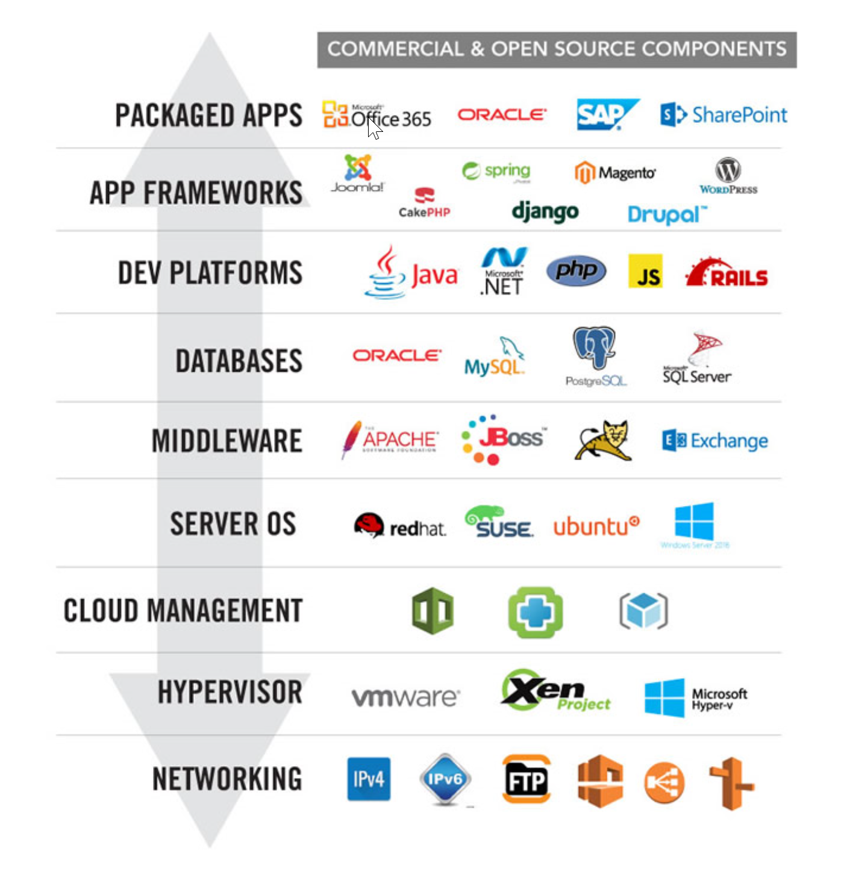
Layers of Need
Speed, Accuracy, & Assurance – Tomorrow’s New Security Paradigm
Assurance -
Certifying Platforms & Overall Environments
Validating 3rd party libraries
Governance & Compliance -
Building security controls in alignment to regulatory requirements
Agile Security Testing -
Testing use cases faster, fixing faster

Slide 10
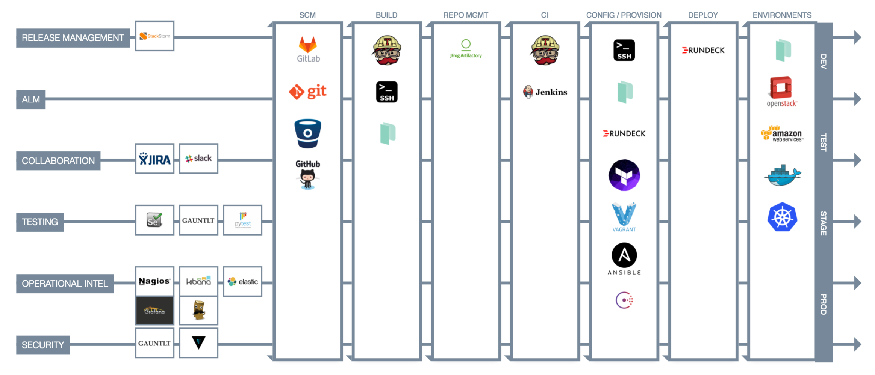
DevSecOps Landscape

Slide 11
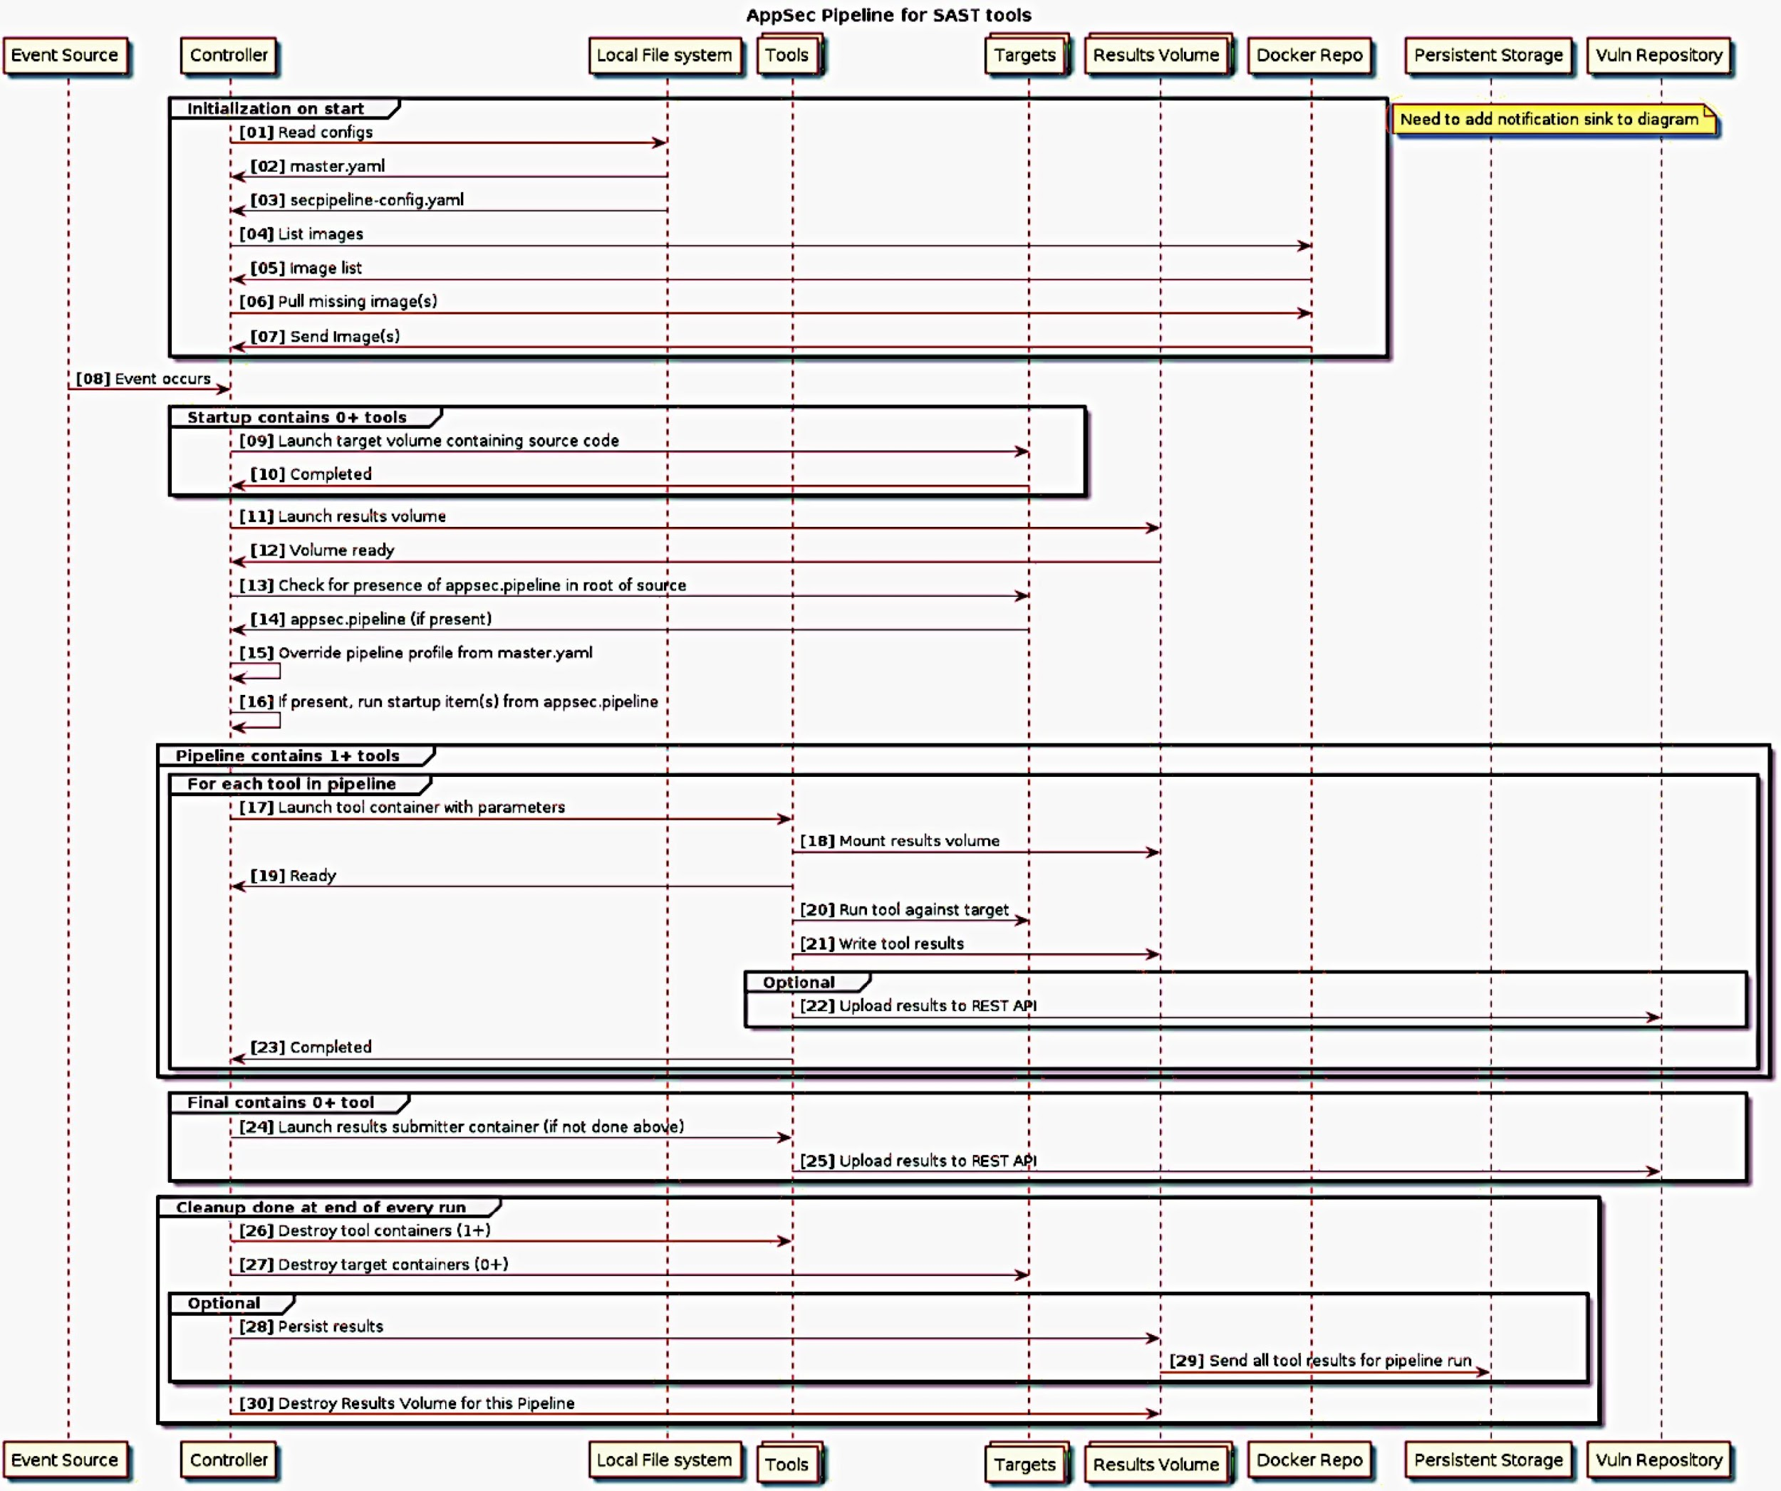
Building an AppSec Pipeline
An AppSec pipeline integrates activities like SAST, DAST as part of process to test, validate, fix and deploy
OWASP has a sample pipeline schematic denoting where integrated testing can occur (see right)
Tools such as OWASP Glue are interesting and still supported to help security efforts in CI/ CD
Ruby Gems project that is fairly well-maintained.
Similar to StackStorm in the sense you are also automating AppSec pipeline https://www.owasp.org/index.php/OWASP_Glue_Tool_Project

Slide 12
Planning DevSecOps
Defining Goals & Leveraging Threat Modeling to Implement DevSecOps Activities

Slide 13
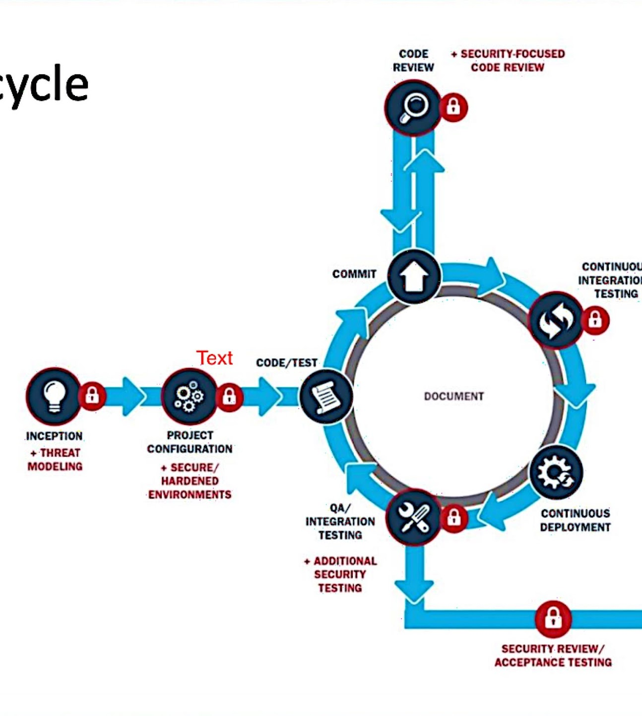
Threat Models as Blueprints
Mapping Automation Opportunities into the SDLC
Threat Modeling not just a point in time activity
Application Threat models provide blueprint for S-SDLC activities
PASTA as a Risk Centric Approach
Full stack
Threat integration
Exploit testing automation
Building Security-In
Building Compliance-In
Provides a collaborative approach to make DevSecOps a planned success vs. ad hoc wish.
versprite.com/security-offerings/appsec/application-threat-modeling

Slide 14
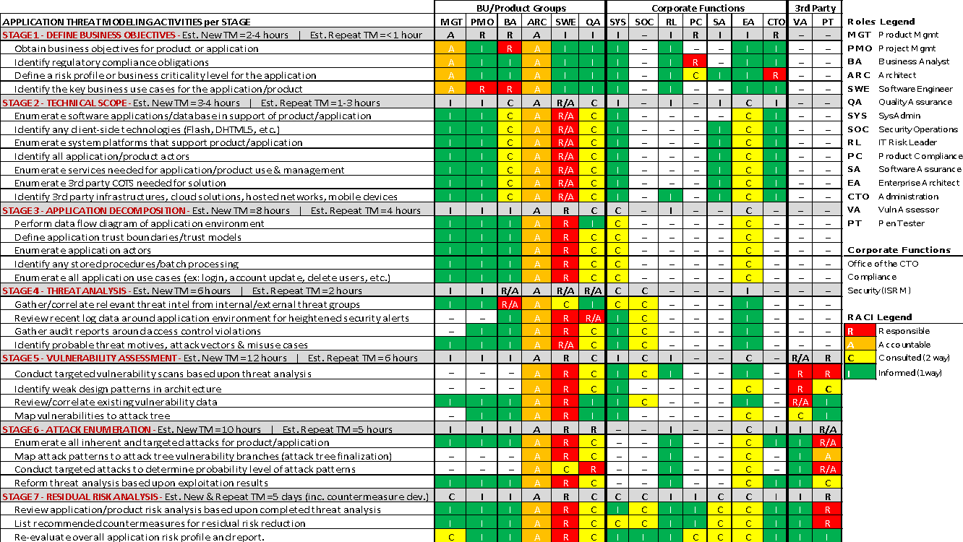

Slide 15
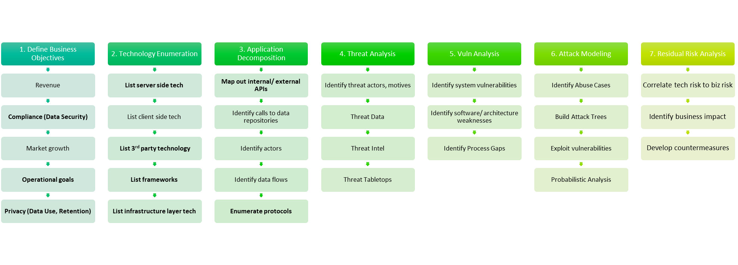
PASTA Threat Modeling Methodology
Incorporate Security Earlier in the SDLC Process

Slide 16
Planning Automation
All Phases are Left of SDLC Deployment Phases
STAGE 1 can define pre-emptive mitigation strategies via hardening, control adherence
STAGE 2 identifies risks stemming from vuln components from attack surface
STAGE 3 understand security context of callers in application architecture.
STAGE 4 can identify threats that can be addressed earlier in SDLC
STAGE 5 & 6 can audit code, app configs, & app responses
STAGE 7 identifies residual risks & determines pass/fail criteria for app acceptance
Stage 3
Stage 4
Stage 2
Stage 1
Stage 5 ,6
Stage 7

Slide 17
Automation Cases
Configuration, Audit, and Implementation Use Cases

Slide 18
Remediation Workflows -
Information Collection
Retrieve logged users (e.g. - actor inventory, security privilege context)
Retrieve listening ports (e.g. - security hardening objectives)
Retrieve established connections (e.g. - PASTA Stage 3)
Retrieve running processes (e.g. - baseline configurations, NIST CM Control Domain)
Retrieve file hashes (e.g. - data integrity)
Retrieve logs from /var/log/* (e.g.- logging, auditing)
Upload information to Rackspace CloudFiles (e.g.- archiving for compliance/ audit review Sharepoint, Confluence)

Slide 19
Operationalizing Governance
Mapping Automation Opportunities into the SDLC
12.3 Use cryptographic controls to protect your information
There are multiple ways to ‘comply’ with a control
Automate checks with Puppet, Chef, Ansible, Vagrant, Terraform
Checks can sometimes run natively on native platforms
Auditor | GRC | 3rd Party Audits | NetSec | SysSec | DB Sec | AppSec
(subjective control presence) | (subjective control presence) | (subjective control presence) | Ex: CA Signing, encryption algorithm | Ex: Disk encryption status | Ex: Field vs. Table Encryption | Ex: employing proper TLS levels for in-transit

Slide 20
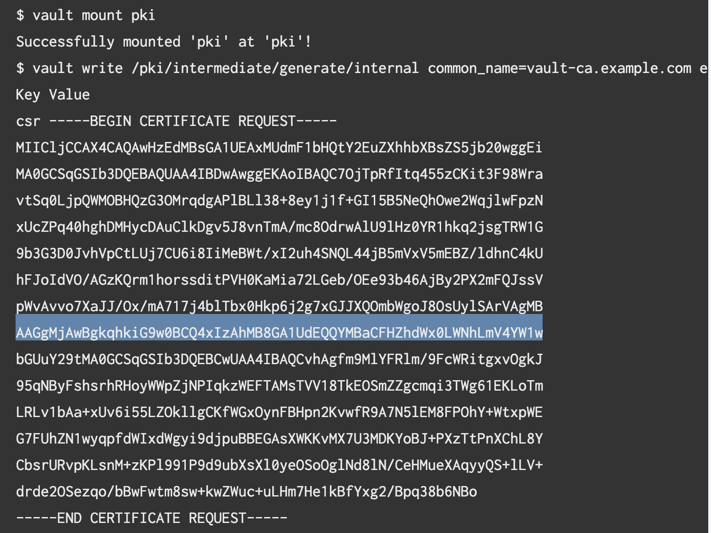
Control Implementation for Crypto
ISO 12.3 Use Cryptographic Controls
Automatically issue TLS certs
Vault feature can be used to automate TLS certs to TLS clients & servers
Validate TLS presence
Provide assurance to client-server environments across desired environments
PROD | STAGE | UAT | QA | TEST | DEV
Terraform scripts interface w/ Vault to generate CSR, issue certs
Chef, Puppet, Ansible all have similar variants for secret/ key management
NetSec Control Implementation Example Using Terraform Vault Provider

Slide 21
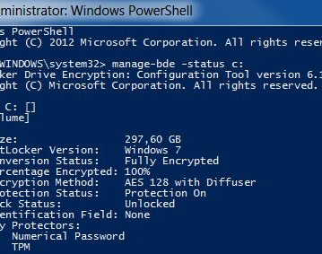
Endpoint Protection Validation
ISO 12.3 Use Cryptographic Controls
SysSec Control Validation Example Using Native Capabilities
Simple powershell script can be checked into any config management tool
Can be run as a service account
Can be run when configuring VMs for any environment
Provides assurance to encrypted file systems
Output can be stored automatically via interfaces to Sharepoint, Confluence, GRC platforms

Slide 22
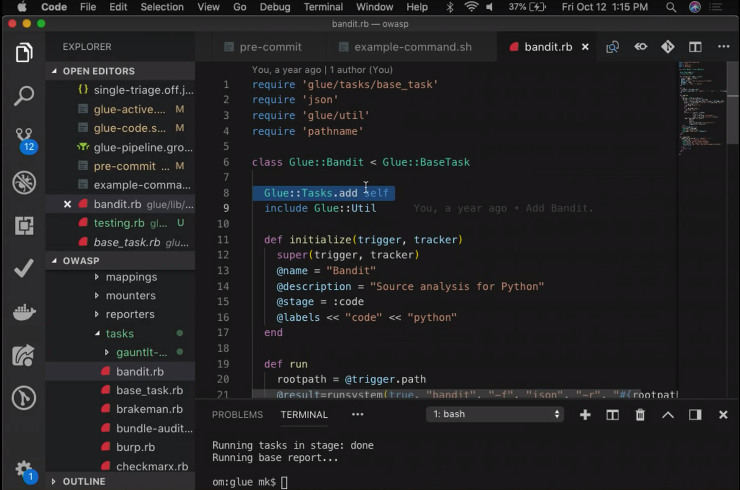
Vulnerability Management Assurance
ISO 12.6 Establish Technical
Integrating SAST via automation tools like OWASP Glue
Linting or static code analysis can be carried out by various tools
Bandit is one for Python
Automatic linting for Python can be automated via tools like OWASP Glue
Targets can include: file systems, git repos, dockerfiles, iso files, etc.)
Series of tasks that can be defined
Bandit task for SAST on python codebase
DAST tasks can be defined w/ ZAP
ruby bin/glue -t zap --zap-host http://localhost --zap-port 1234 –z p-passive-mode http://juice-shop
TeamCity Integration Example
ruby bin/glue -t zap --zap-host http://localhost --zap-port 1234 --zap-passive-mode http://juice-shop -f teamcity

Slide 23
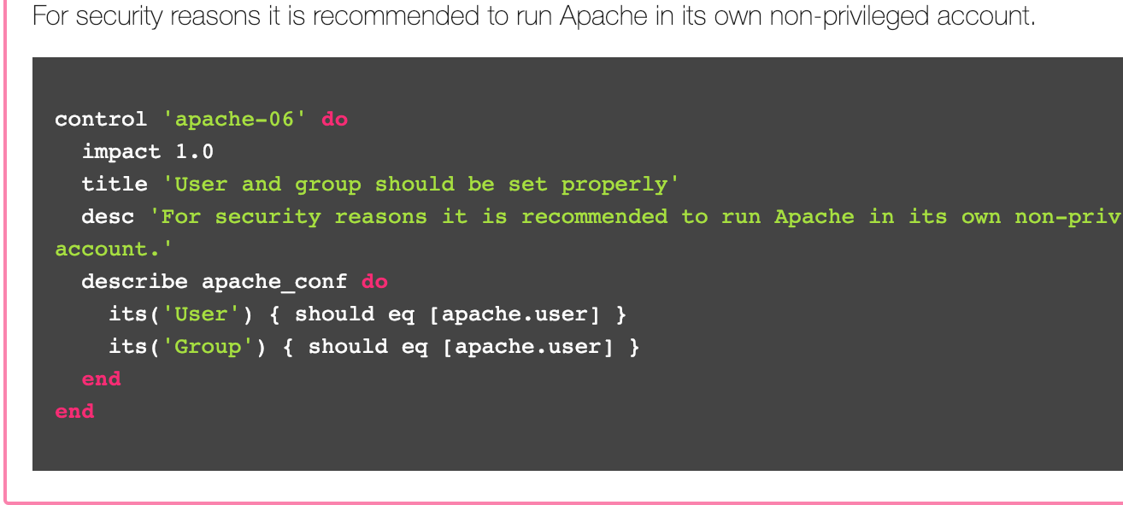
11.2.2 Control the Management of System Privileges
All Phases are Left of SDLC Deployment Phases
Another ISO Control Implementation (ISO 27002 11.2 Domain)
Ensuring the security context of actors running 3rd party software or internal software is not elevated
Chef automation scripts can validate Apache web server environments that are in scope
Multiple baselines exist and can be code as checks using Ansible, Chef, Puppet
Great resource: https://dev-sec.io/baselines/apache/

Slide 24
Moving Forward
Resources & Practical Advice

Slide 25
Did you know?
Security product vendors want to have customers that use their products.
DevSecOps can leverage many security, compliance products today; find the ones that work.
DevSecOps can increase TCO for current solutions and help create workflows via integration

Slide 26
Leveraging PASTA to Encompass Goals & Scope
ISO Controls for Automation
Define Goals: Compliance? Improved Security Posture? Security Cost Reduction? IP Preservation
Regulatory landscape for application(s)
Identify Attack Surface
This will be the object of DevSecOps automation
Understand Flows via App Decomposition
Static API Calls,
SAST/ DAST reports
Actors & their Security Context
13.1.2 – DAST Automation via Jenkins & Zed Attack Proxy
12.1.1 Identify InfoSec requirements
11.4.2 Auth remote user connections
12.4 - Protect Source Code

Slide 27
Leveraging PASTA to Encompass Goals & Scope
ISO Controls for Automation
Threat Analysis
Harvest alerts that feed triggers on OWASP Glue, StackStorm
Vuln/ Weakness Detection
Go beyond the AppStack (concern for integrated dependencies)
CVE, CWE to CAPEC mapping
Attack Modeling
Automated & Integrated SAST / DAST
Queuing for manual exploits (vFEED)
Residual Risk | Countermeasure Development
Getting to remediation quicker
Eliminating time spent on FPs
13.1.2 – DAST Automation via Jenkins & Zed Attack Proxy
12.1.1 Identify InfoSec requirements
11.4.2 Auth remote user connections
12.4 - Protect Source Code

Slide 28
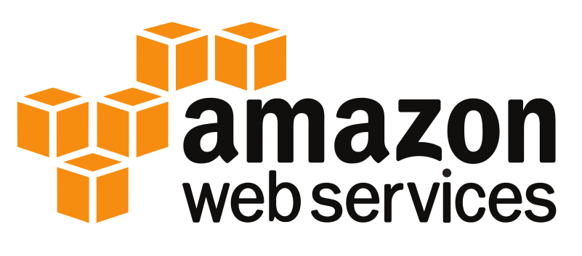
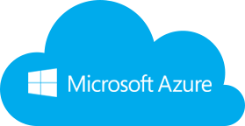
Cloud Security – Great Frontier for DevSecOps
Assessment and Remediation
Low-touch high-value assessments for your Cloud environment ideal for baseline, testing and monitoring remediation.
Utilize control guidance defined by CSA 3.1, CIS benchmarks, Microsoft and Amazon.
Automated checks continually evolving; leverage global security and DevOps communities for custom building security pipelines that fits your needs
Key areas covered:
Public attack surface
Identity & Access Management
Networking
Virtual Compute (VM)
Application Containers
Storage
Database
Logging and Alerting
Security Center (Azure)
Security Hub/GuardDuty (AWS)

Slide 29
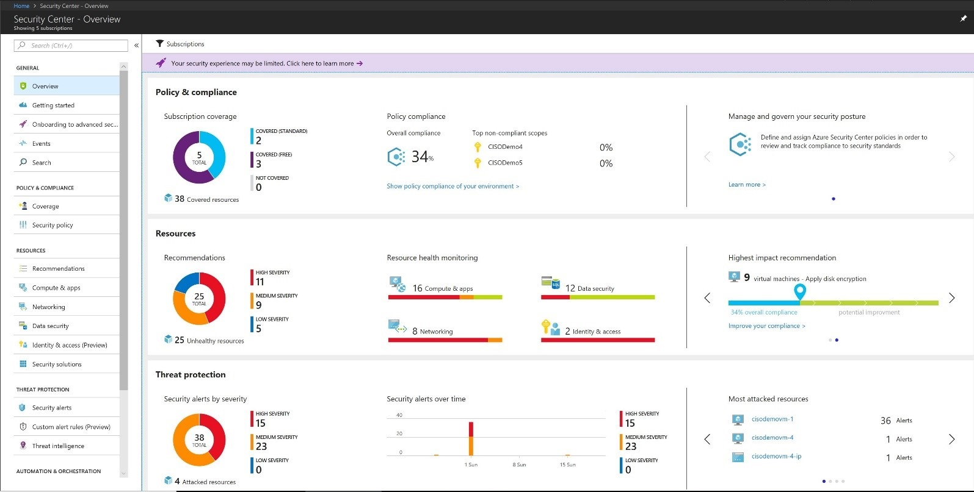
Cloud Security Auditing
Control Domains and Compliance
Focus coverage of HIPAA/HITECH, ISO 27001, FedRAMP.
Cloud controls (automated checks) mapped directly to compliance control domains.
Example mappings:
CIS Benchmarks for AWS 1.1-1.16 (IAM) => ISO 27001 control domain 9.x
CIS Benchmarks for Azure 5.1- 5.13 (Logs) => HIPAA 164.308
Data encryption (S3, Database) => FedRAMP SC-13
Monthly audit drives evidence collection supporting audits for baseline and deltas.
Integrate control results into Azure Security Center and AWS Security Hub (in preview) for central dashboard.

Slide 30


Thank You
tonyuv@versprite.com
https://www.linkedin.com/in/tonyuv/
@t0nyuv

